Slide 1
Unicef/Adelson
Notes:
March 2020, United States of America.
Julia, 16, attends online school from home while her parents telework during the Coronavirus outbreak in New York. This is her first day of distance learning.
Unicef/Adelson

Slide 2
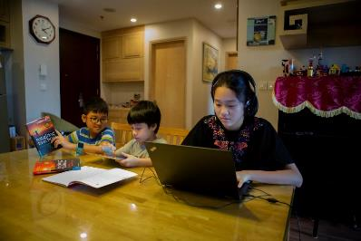
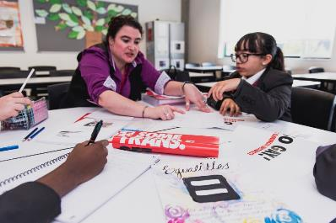
Guess the article
These pictures provide a clue to this week’s article.
How do these pictures help you? Can you guess how they are linked together?
Write down your thoughts or discuss with someone in your house.
UNICEF/Dejongh
UNICEF/Viet Hung
Unicef/Clazie Flynn

Slide 3
Introducing… Article 28
Jilly introduces Article 28
Article 28 – the right to education
Every child has the right to an education.
Primary education must be free and different forms of secondary education must be available to every child.
Discipline in schools must respect children’s dignity and their rights.
Richer countries must help poorer countries achieve this.
Watch Jilly on YouTube

Slide 4
Why is the right to education important?
Give yourself one minute to think of as many reasons as you can why education is important for children and young people.
You might like to ask someone else in your house to do this too. At the end of one minute share your thoughts and then compare with the ideas on the next slide.

Slide 5
How many of these did you get?
Education is important to children and young people because it will help them to:
have skills to improve things and help people
form opinions and views about things
learn things, gain knowledge and pass exams
know how to stay safe and healthy
learn how to respect other people’s ideas and get on with other people
get a job they enjoy and earn money
make informed choices
have more opportunities in life
learn about things that are important for the world
grow up to be responsible adults

Slide 6
Activity Time
What do you think makes a good teacher? This video might give you some ideas! Draw an outline of your ideal teacher and surround it with words that describe what that teacher is like.
All these activities are related to…
Imagine you have been asked to create your ideal lesson timetable for a day or a week at home or in school. Plan it out and decide what you would include and what you would leave out. Make sure it will provide children with a really good quality education!
. Teachers and leaners go together! So now think about what makes a good learner? Imagine you are talking to a younger brother, sister or friend who is about to start school. Describe to them how to be a really good learner! Invent a cartoon character to represent this good learner.
You don’t need to do every single activity
but if you have time you can do more than one.
Primary

Slide 7
Activity Time
If you became the new Education Minister in the government – what would be the first thing you would do? Think carefully about what you think children and teachers need. You could have a go at writing your first speech describing the improvements you would make.
Watch ‘Education is every child’s right’ video and use it to help you create a poem about education and learning.
You could begin:
Education is a right
Education is hope
Education is…
You might like to browse through this lovely new book ‘The Book of Hopes’ dedicated to everyone working in hospitals during coronavirus. Choose a poem or a story that you feel is special, Jilly chose ‘Hope or learning the Language of Birds on page 76? If you find a favourite, share it with somebody at home or safely online with a friend or family member.
Schools and teachers do so much more than teach you facts. Think of every thing that happens at your school – how the adults look after you and treat you with dignity and respect, how you look after each other. Now write a ‘recipe’ for a Rights Respecting School. What are the ingredients e.g. respect, safety. How do you mix them together to create the best rights respecting learning environment?
Primary

Slide 8
Activity time
Imagine you have been asked to create your ideal lesson timetable for a day or a week at home or in school. Plan it out and decide what you would include and what you would leave out. Make sure it will provide children with a really good quality education!
These activities will help you
understand how...
…can relate to your life.
You don’t need to do every activity, just do as many as you can.
We began by thinking about why the right to an education is important. Watch this video which explores this a bit further – do you agree with all the ideas? Would you like to add anything else? How could it be even better? Create an image or word art that sums up what education means to you.
What makes a good teacher? Watch this video – what does it tells us about the importance of the relationship between a teacher and a learner ? How did you feel after watching the video? is there something you feel you could be (or are!) really good at? Write a job description for your ideal teacher!
Secondary

Slide 9
Activity time
Article 28 also says that ‘Discipline in school must respect children’s dignity’. What do you think this means in practice? Imagine you are the Headteacher of a new school, as well as ‘dignity’, what other three values would you place at the heart of your school? How can you ensure that everyone respects these values? Design a school motto or logo to illustrate this.
Nelson Mandela said: ‘Education is the most powerful weapon which you can use to change the world’ and Malala Yousafzai campaigns to raise awareness of the importance of education for girls – watch this video or do your own research and highlight 3 key points about why it is important for girls to go to school. How might you use these 3 key messages to start your own campaign for girls’ education?
Although more children than ever go to school across the world, the quality of the education they receive is not always good enough for real learning to take place. Watch this video in which Henrietta Fore, Unicef’s Director, talks about the importance of children learning at school. What do you think is needed for quality learning to take place?
Talk to relatives or friends who are older than you and ask them what school was like for them. What are their best and worse memories? How has school changed? How do you think knowing about rights improves life and learning in school?
How do you think education should develop in the future ? Watch this video, to what extent do you agree with the ideas suggested? Should schools focus on teaching knowledge or values and skills? Talk about this with people in your house or with your friends.
Secondary

Slide 10
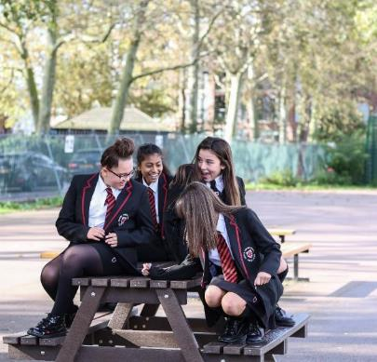
Reflection
Think about your own learning for a few minutes – your own learning in school and outside of school.
What do you love learning about the most?
What are you passionate about? What makes you excited to get up in the morning?
What are you good at? Or would like to be better at?
How do you learn best?
Now re-imagine a new kind of school that fitted you exactly. What would it be like? Would it be an actual building? A workshop? A studio? A virtual school? Or an outside space? Let your imagination run…
UNICEF/Dejongh

Slide 11
Extension
Children’s rights are universal and indivisible and the right to a good quality education is an example of how rights are interdependent.
For a child to enjoy a good quality education lots of other rights need to be accessed too – health for example. You can’t learn effectively if you are unwell.
Think about which other rights are important if all children are to enjoy their right to learn?
You can find a summary of the whole Convention here
UNICEF/Dawe

Slide 12
Thank you

